Slide 1
AlGORITHM PROJECT
A
Team
ash
s
h
Anuj singh : 19EC10009
Sarthak goyal : 19EC30039
Harsh sukheja : 19EC30015

Slide 2
iNTRODUCTION
Every year, lakhs of students in India give the entrance exam for IIT’s and NIT’s i.e., JEE advanced.
But it doesn’t end for them yet, They wait for results, and when they come out, some gets excited and celebrate it and some gets depressed.
After the results, there comes the trickiest part in which they have to go through a crucial choice making process called JoSSA seat allocation process.

Slide 3





StoryBoard
BRIEF INTRO ON HOW WE CAME UP WITH THIS TOPIC AND THIS PPT
15 JAN
18 JAN
25 JAN
30 JAN
31 MARCH
MADE THIS TEAM
COOKED UP AN IDEA
SUBMITTED FOR APPROVAL
CAME UP WITH THE ALGO
PPT WAS SUBMITTED

Slide 4
OUR Motivation
Before going deep into our algorithm, let us look at another problem called stable marriage problem.
Problem Statement: Consider a dating agency that must match up n men and n women. Each man has an ordered preference list of the n women, and each woman has a similar list of the n men. Is there a good algorithm that the agency can use to determine a good pairing?
What properties should a good pairing have? One possible criterion for a “good” pairing is one in which the number of first ranked choices is maximized. Another possibility is to minimize the number of last ranked choices. Or perhaps minimizing the sum of the ranks of the choices, which may be thought of as maximizing the average happiness. In this solution we will focus on a very basic criterion: stability. A pairing is unstable if there is a man and a woman who prefer each other to their current partners. We will call such a pair a rogue couple. So a pairing of n men and n women is stable if it has no rogue couples.

Slide 5
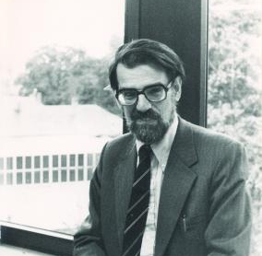
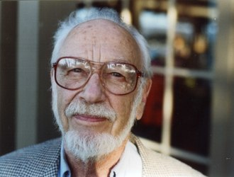
aLGORITHIM
Gayle Shapely algorithm
The proposed algorithm below is famously known as Gayle Shapely algorithm
Traditional Propose & Reject Algorithm:
Every Morning: Each man goes to the first woman on his list that has not yet crossed off and propose to her.
Every Afternoon: Each woman says “maybe” to the man she likes best among the proposals (she now has him on a string) and “never” to all the rest.
Every Evening: Each of the rejected suitors crosses off the woman from his list.
The above loop is repeated each successive day until there are no more rejected suitors. On this day, each woman marries the man she has on a string.

Slide 6
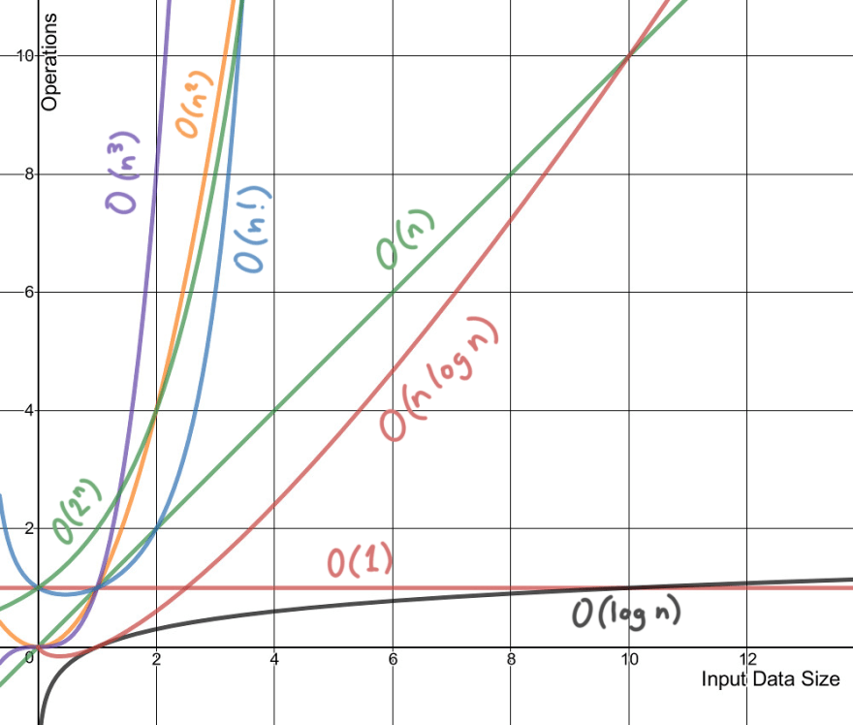
TIME COMPLEXITY for gayle shapley algo
Let us prove something stronger: the algorithm is guaranteed to terminate in at most N² days. Well, for each day (except the last), at least one woman is crossed off some man’s list. Since there are N men, each starting with a list of size N, it follows that the algorithm must terminate after N² days.
HENCE COMPLEXITY = O(N²)

Slide 7

MORE INSIGHT
Looking at the stable marriage problem, we wonder that the same process can be applied for JoSSA seat allocation. JoSSA is an umbrella for all IITs and NITs. This process ensures that a student gets his best possible as well as desired option. Also if someone withdraws from the seat allocation process, then we incorporate multiple rounds to ensure that no seat gets wasted.

Slide 8
What it has to do with our problem STATEMENT ?
Much like the Gayle shapely algorithm, the n men here represent the students appearing for JoSSA counselling process and the women here represent the institute/seat.
But unlike in previous case, here each institute can have up to m seats i.e., it can accommodate n students.
Also, here priorities of institute are fixed i.e, in the order of AIR’s.
Assuming this fact makes our algorithm much simpler to execute and hence we do not follow the exact procedure of Gayle shapely algorithm.

Slide 9
Our algorithm
PSEUDO CODE FOR ALGORITHM
structure choice{ int insti;
int branch;
int choiceno;
structure choice *nextchoice}
structure stulist{ int rank;
int insti;
int bran;
int status;
int choiceno;
choice *c;
structure stulist *nextstu}

Slide 10
PSEUDO CODE FOR ALGORITHM
main()
{
instis = no. of institutions
brans = no. of branches
maxstu = max. capacity of a branch
stus = total no. of students
define an array of stulist called p of length stus
initialize all elements of p to be NULL
for(all the students)
take r which is rank of student as input
while(p[r] != NULL OR (invalid rank))
{
Again take rank as input
}
create a stulist at p[r]
p[r]->rank = r
p[r]->status = 1
take_choices(p[r])
convert the array of poiters of stulist into a linked list where the address of first address is start
#define a double array mat to store the remaining capacity of each branch

Slide 11
PSEUDO CODE FOR ALGORITHM
mat = Round1(start,instis,brans,maxstu)
#print the results of round 1
printc(start)
#take the option a student has selected as input and reallocate if possible
round2(start,mat)
#print the results of round 2
printc(start)
}

Slide 12
PSEUDO CODE FOR ALGORITHM
void take_choices(stulist *p)
{
k = 1,n = 1
choice *c,*f //c to store the start point and f to iterate
define c to be a structure
f = c
take f->insti and f->branch as input
f->choiceno = 1
f->nextchoice = NULL
n++
take input k //if user doesnt want to give another choice than 0 else 1
while(k)
{
create f->nextchoice
f = f->nextchoice
f->choiceno = n
take f->insti and f->branch as input
take input k //if user doesnt want to give another choice than 0 else 1
n++
}
p->c = c
}

Slide 13
PSEUDO CODE FOR ALGORITHM
double array Round1(stulist *start,int instis,int brans,int maxstu)
{
define matrix mat of length instis * brans
initialize each element to be maxstu //each element signifies the max no. of students which can enter at the moment
for(start != NULL)
start->insti = -1;
start->bran = -1;
start->choiceno = -1;
choice *c = start->c;
while(c != NULL)
{
if(there is a place in the choice left)
{
allot the choice
decrease the capacity of choice in mat by 1
break
}
move to next choice
}
start = start->nextstu
return mat
}

Slide 14
PSEUDO CODE FOR ALGORITHM
void Round2(stulist *start, int **mat)
{
while(start != NULL)
{
take status of student as input
check if the status is not slide or freeze given no choice is allotted to the student, if so take another status as input
if(start->status = withdraw)
{
if(start->insti != -1)
mat[start->insti][start->bran]++;
start = start->nextstu;
continue
}
if(start->status = float)
{
follow same process as roundd1, if a diff choice is alloted increase the capacity of previous choice by 1 and decrease the capacity of new choice by 1 in mat
start = start->nextstu;
continue
}

Slide 15
PSEUDO CODE FOR ALGORITHM
if(start->status = freeze)
{
start = start->nextstu;
continue;
}
if(start->status = slide)
{
do the same as float and only allot a new choice if start->insti is same as new choice
increase the capacity of previous choice by 1 and decrease the capacity of new choice by 1 in mat
}
}
}

Slide 16
PSEUDO CODE FOR ALGORITHM
void printc(stulist *start)
{
for(iterating over all students with the help of start)
if(start->status == 0)
print the student has withdrawn from the councelling
else
if(start->status = -1)
print no seat is alloted
else
print the choice alloted
}

Slide 17
Float, freeze and slide
Freeze: Candidates accept the offered seat and indicate that they are content with the allocated academic program and that they do not want to participate in further rounds of seat allocation. Such candidates will NOT be considered in subsequent rounds of admission.
(B) Float: Candidates accept the offered seat and indicate that, if admission to an academic program of better/higher preference in any Institute is offered, they will accept it. Else, they will continue with the currently accepted academic program. Such candidates will be considered in subsequent rounds of admission.
(C) Slide: Candidates accept the offered seat and indicate that, if admission to an academic program of better / higher preference is offered within the same Institute, they will accept it. Such candidates will be considered in subsequent rounds of admission.
(D) For candidates who choose the float or slide option, allocation of a seat in an academic program of his/her higher preference would automatically result in the forfeiture of the seat accepted by the candidate in the earlier round.
Slide and float options will be available to only those candidates who are NOT offered admission to their first choice.
Slide and float options are NOT available in the last round of seat acceptance.

Slide 18
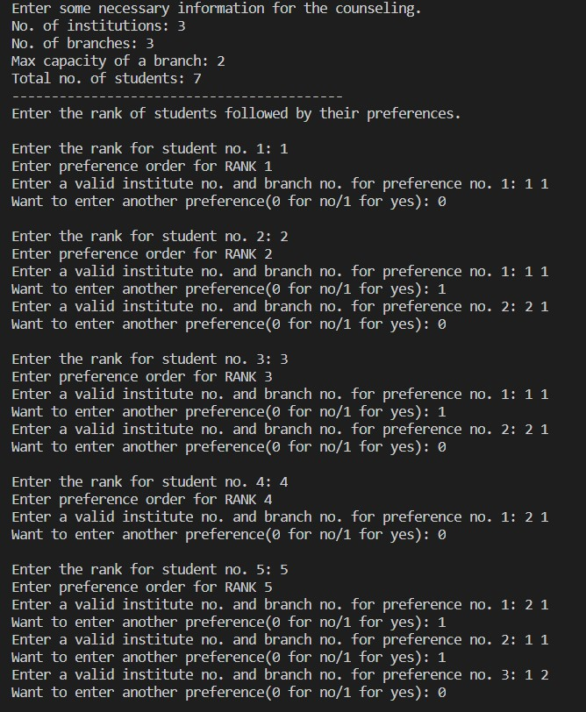
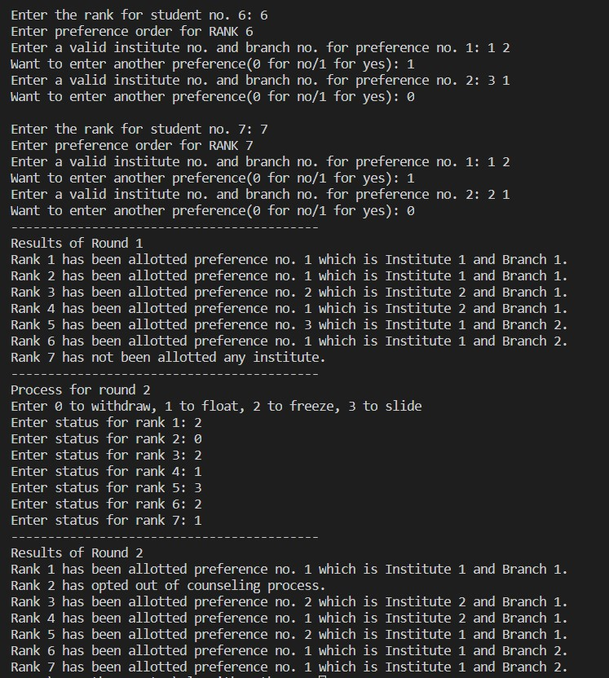
INPUT AND OUTPUT

Slide 19
TIME COMPLEXITY of our algorithm
Let number of students participating in JoSSA counselling process be N. The number of institutes and branches per institute be M, B respectively. We first sort the students rank using count sort which takes O(N) time. The maximum choices a student can fill is M*B. We are iterating on each students list in our algorithm only once and either we are allocating him the seat and terminating or that seat is already occupied and we continue. Thus, taking O (1) time for each choice filled by student. Hence the total time complexity of our algorithm becomes
O(N*M*B)

Slide 20
PROOF OF CORRECTNESS
The proof of our algorithm is much simpler than that of Gayle shapely algorithm as
In here we traverse through list of students in increasing order of their rank.
We allocate rank 1 its best choice, rank 2 its best possible choice and so on…
Let A, B (A<B) be the rank of students. It can always be shown that if they have filled the same choice, then B will not get that seat until A has.
This ensures that better ranks get to assert its right on a seat before a lesser rank.
Further if someone adopts to opt out the counselling process, the seat does not get wasted as we have multiple rounds following the same structure as round 1.

Slide 21
THANK YOU

